Slide 1
EMSE 6574 – Programming for Analytics: Python 101 – Python Enviornments
Joel Klein

Slide 2
Setting up Python

Slide 3
Python 2.7 vs 3
Python 2.7 is a legacy version of python
On many machines this may be the default version installed (mac and Linux) due to compatibility
We will be using python 3.6 for this course for the most recent versions of packages

Slide 4
Python Distributions
Python Distributions:
Anaconda (using in lab) - https://www.continuum.io/downloads
Available on all systems
Canopy - https://store.enthought.com/downloads/#default
Available on all systems
WinPython - https://winpython.github.io/
Windows specific data science distribution
Using a distribution simplifies the process of setting up your python environment, includes necessary data packages, and integrate useful tools (IDE’s, notebooks, etc)
In class we will be using the Anaconda Distribution

Slide 5
Anaconda

Slide 6
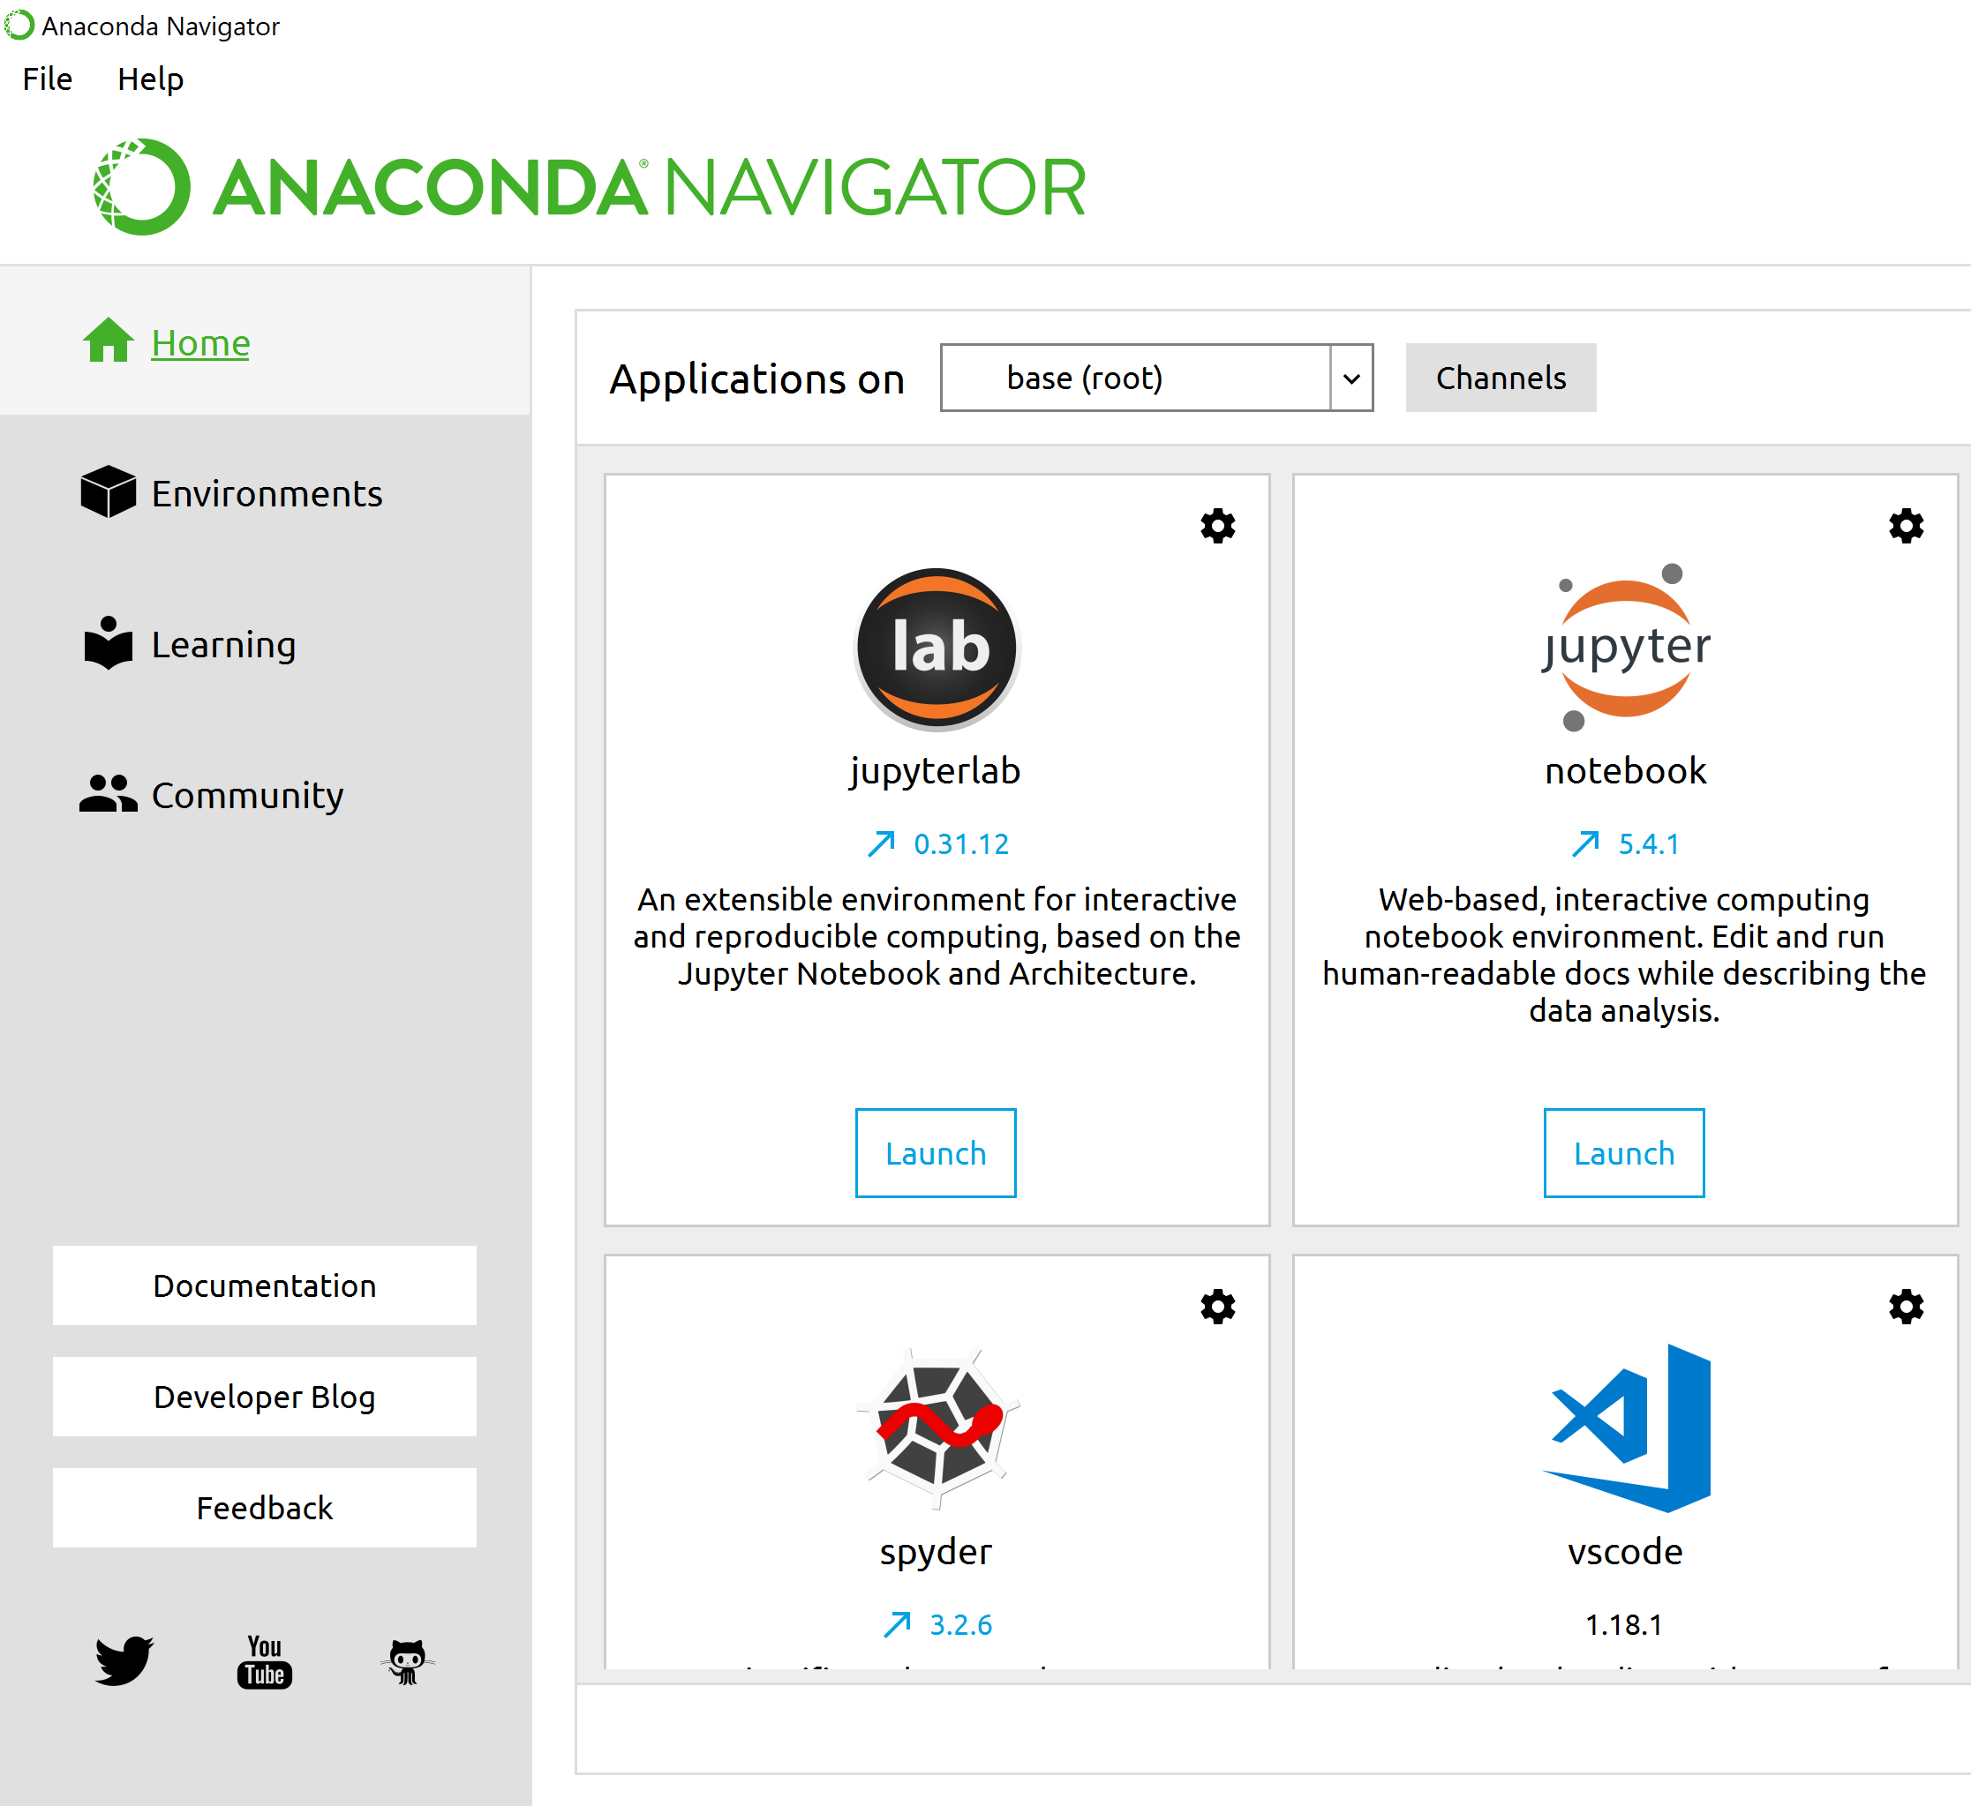
Anaconda Navigator
The Navigator is a main landing page for working with your python environment.
Here we can launch editors (spyder, jupyter notebook, etc.) to write and develop python code
In addition we can manage (install packages, etc.) our python environment
Notes:
Anaconda makes installing certain types of packages a lot easier (numpy, sklearn, tensorflow, etc.)
Anaconda ensures that all of these different tools run on the same version of python packages
Packages are so important because they enable us to use tested and pre-built functionality in python (ml algorithms/stats/etc.)

Slide 7
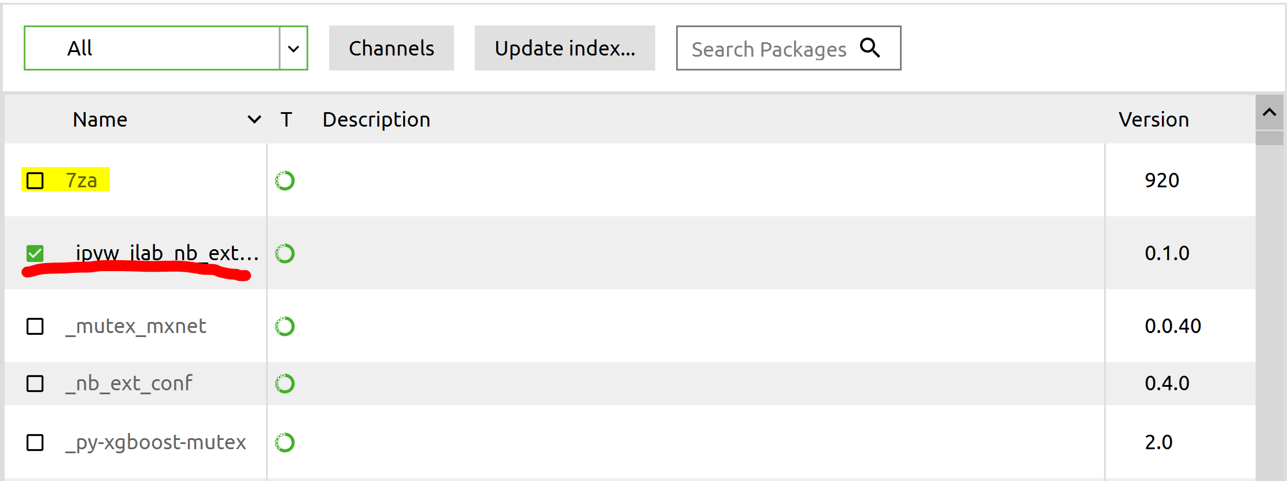
Anaconda Environments
Clicking on the “Environment” tab will show us what environments are available in Anaconda
In the simplest terms, an anaconda “environment” is a self-contained collection of python packages.
From the “Enviornment” tab we can see which packages are installed and which packages are available for installation.
If you click on a package for installation, you’ll be prompted to Apply your changes

Slide 8
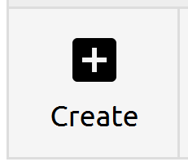
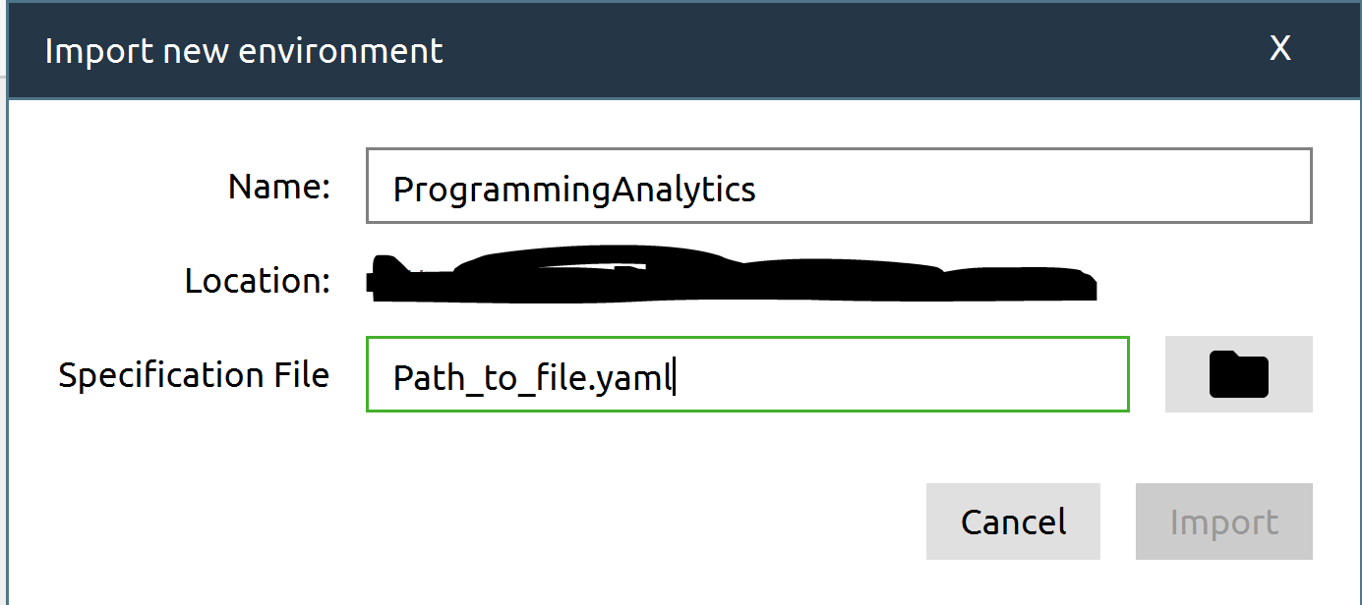
Setting Up Class Environment
For this class I’ve provided an environment file on blackboard. This environment should include all of the packages necessary for the class and can be installed as follows:
Navigate to the “Environment” tab in Anaconda.
Click on the “Create” button
On the resulting window, provide a name for your environment
Next (for specification file) navigate to the provided .yaml file
Import

Slide 9
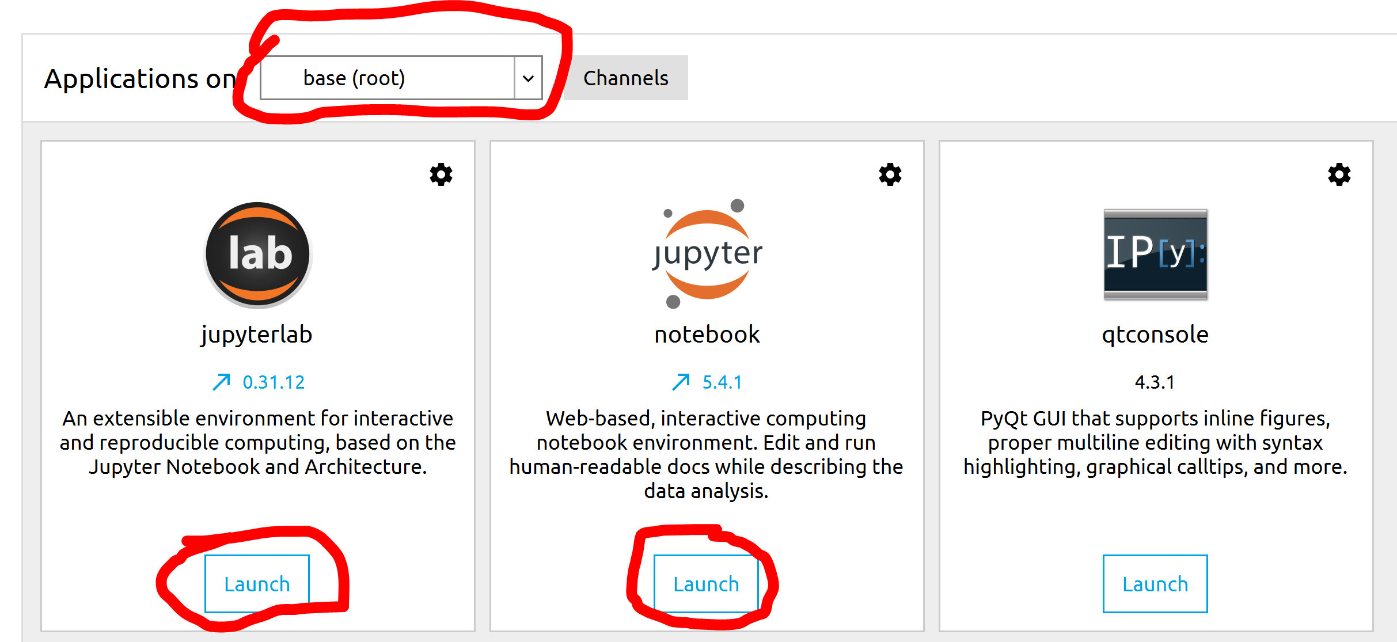
Anaconda Applications
On the home page we can choose which environment (base(root) in the img) we want to launch applications from.
Clicking the “Launch” button on any of these applications will launch a separate window.

Slide 10
IDE’s and Text Editors

Slide 11
Spyder
Spyder is an IDE (Interactive Development Environment) for python that is built into Anaconda (it can be installed on its own).
Features: Built in python console Built in debugging Variable Explorer | Drawbacks: Limited configuration Debugging can be temperamental Limited autocomplete

Slide 12
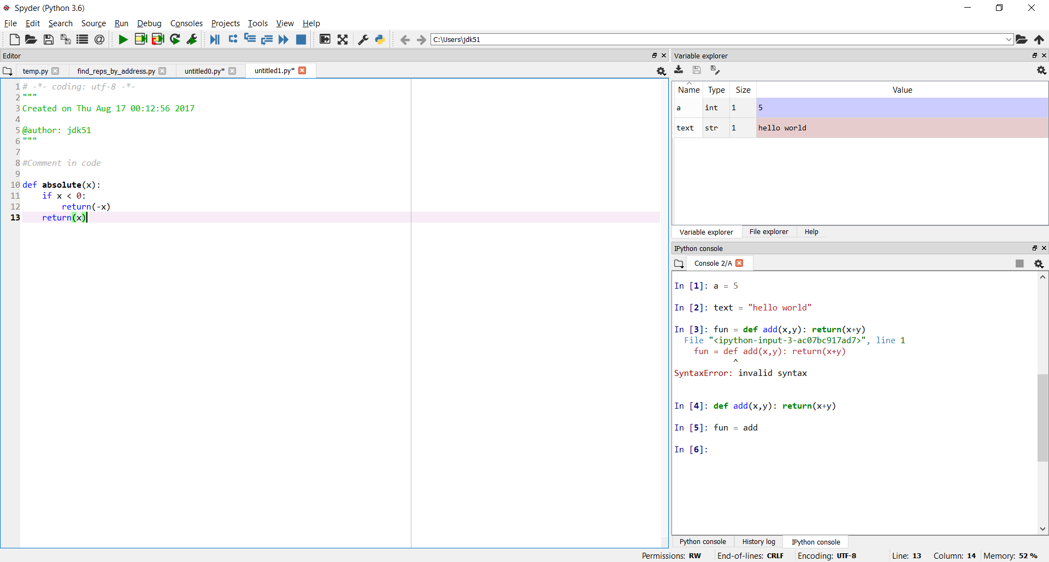
Debugging Tools
Variable Explorer
Text Editor
Python Console

Slide 13
PyCharm
PyCharm is a more fully featured IDE which has a lot of tools used for project management.
It is a more complicated piece of software, and will require connecting to your anaconda distribution, but it has a lot of nice features
Good debugging
Lots of customization
Integration with GIT
Etc.

Slide 14
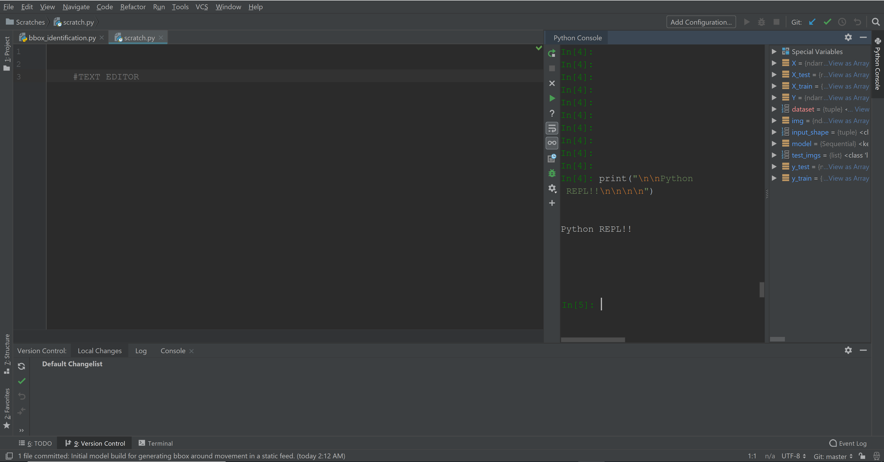

Slide 15
Sublime/Atom
Sublime and Atom are both very popular text editors that enable high level of configuration and package managers for additional functionality
Features: Multi-language support Package manager to add functionality Jump to function definition | Drawbacks: Python console not easily integrated Autocompletion is temperamental Debugging is manual (pdb??)

Slide 16
Sublime Example
Package Management
Text Editor

Slide 17
Questionnaire Time!

Slide 18
Backup Slides

Slide 19
Installing Python Directly
Python can be installed directly using an installer or package manager
Individual Installation:
https://www.python.org/downloads/release/python-361/

Slide 20
Package Management

Slide 21
Installing Packages
Python packages are what enable us to extend the functionality of python to better fit our needs
Anaconda comes with a number of essential packages (scikit-learn, NumPy, Pandas, etc) we will be using throughout this course, but it may be necessary to install additional packages as needed
Pip is the primary method for installing packages, but Anaconda also has an internal package management tool

Slide 22
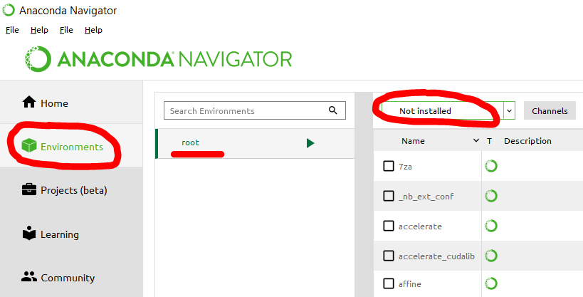
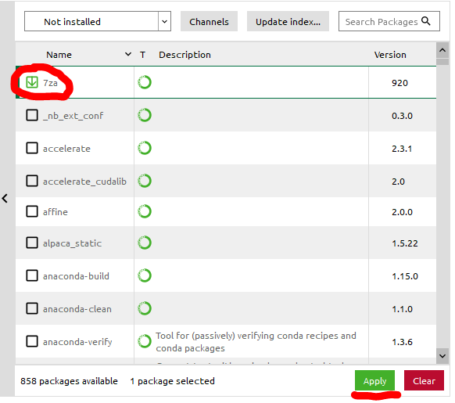
Installing Packages with Anaconda
Navigate to the Environments tab in Anaconda Navigator
Ensure you’ve selected the root environment
Filter the packages by “Not Installed”
Select the required package
Apply the changes

Slide 23
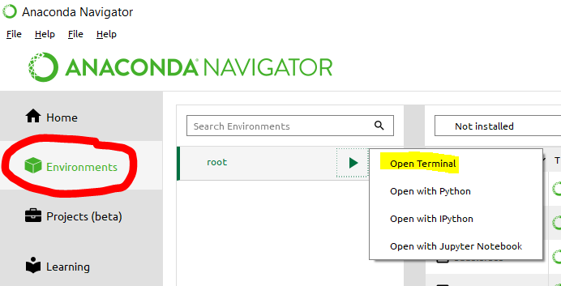
Installing Packages with pip
Open up a terminal connected to python (python needs to be a part of the PATH)
Run “pip install {package-name}”
Note:
You can access a terminal connected to python in Anaconda from the environments tab. From there just hit the play button and then “Open Terminal”

